Slide 1
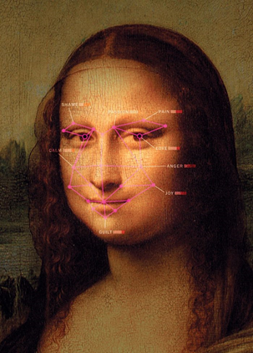
Emotions Classification

Slide 2

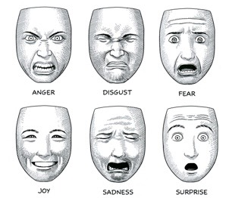
Business understanding
There are six to fifteen basic emotions
Facial expressions are produced by combinations of facial muscles known as Action Units (AUs).
(Ekman, 1994, 2016; Ekman & Cordaro, 2011 ; Kelter & Cordaro, 2015 ; Russell, 1994)
Notes:
Emotions and facial expressions are integral parts of human communication.
In general, there are six to fifteen basic emotions.
We can see in the slide the six classic and familiar emotions: anger, disgust, fear, joy, sadness, and surprise.
Each emotion is represented by different Action Units.
Action Unit is a combination of facial muscles that produce different facial expressions.

Slide 3
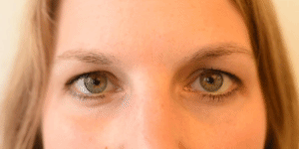
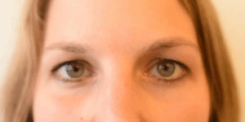
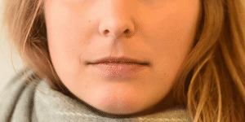
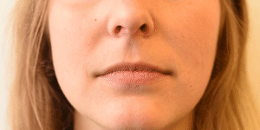
Cheeks Raiser
Inner Brows Raiser
Example for AUs
Smile
Lip Corner Depressor
Joy
Sadness

Slide 4

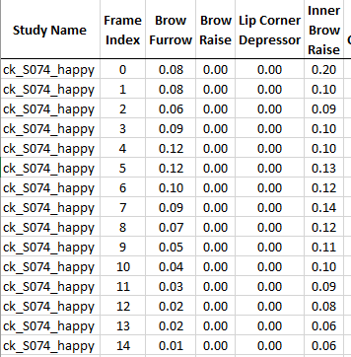
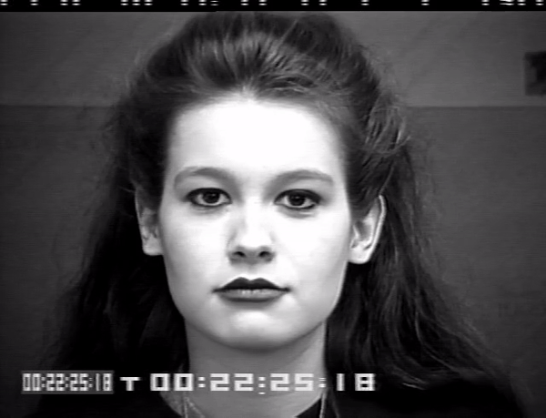

Data Understanding
Cohn-Kanade (CK) database (2010)
117 participants, 7 emotions, 317 short movies

Slide 5
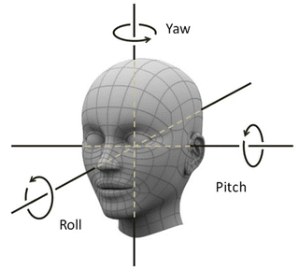
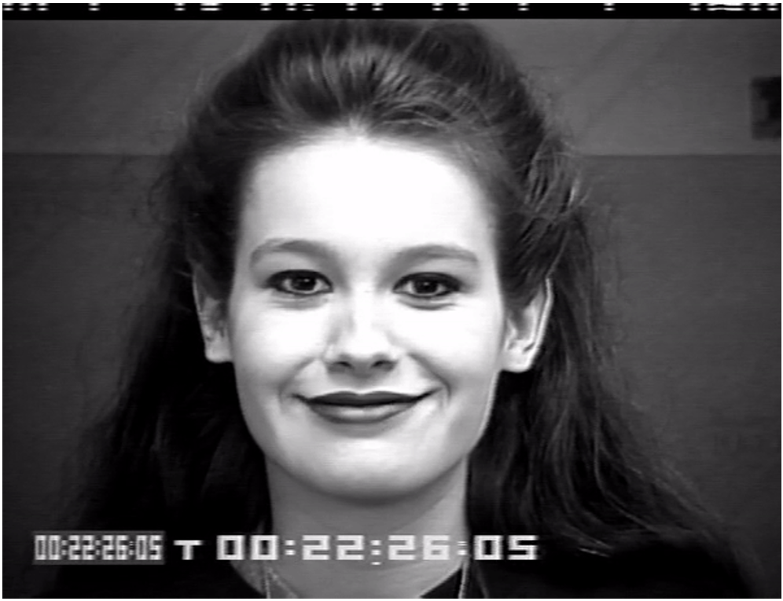
22 features
23 features
Brow Furrow
Brow Raise Eye Closure Eye Widen Inner Brow Raise Lid Tighten Nose Wrinkle
Lip Corner Depressor
Upper Lip Raise
Lip Suck
Lip Press
Mouth Open
Chin Raise
Smirk
Lip Pucker
Cheek Raise
Dimpler
Lip Stretch
Jaw Drop
Pitch
Yaw
Roll
Feature description
Head features norm

Slide 6
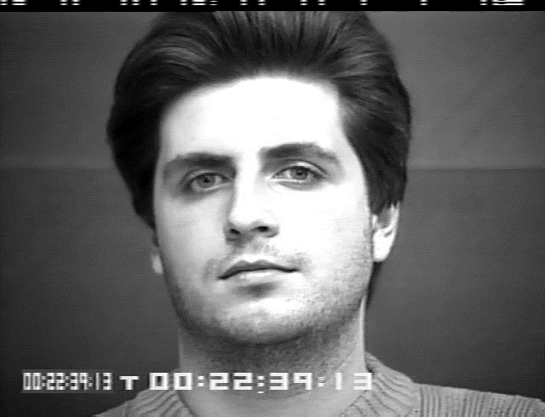
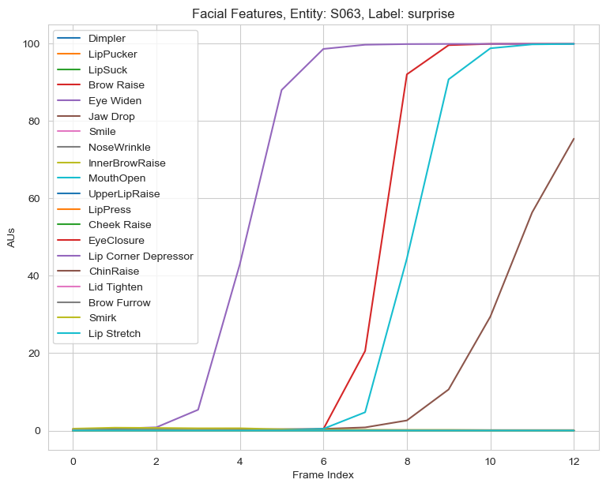
Expressing Emotion - Example
Notes:
This is an example of expressing emotions and how the features change over time.

Slide 7
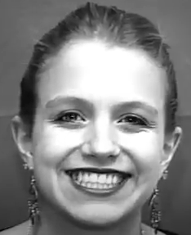
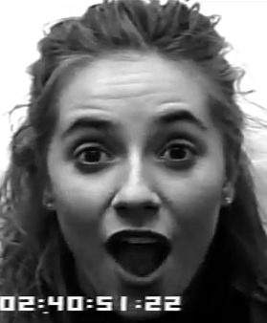
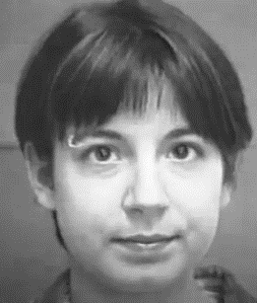
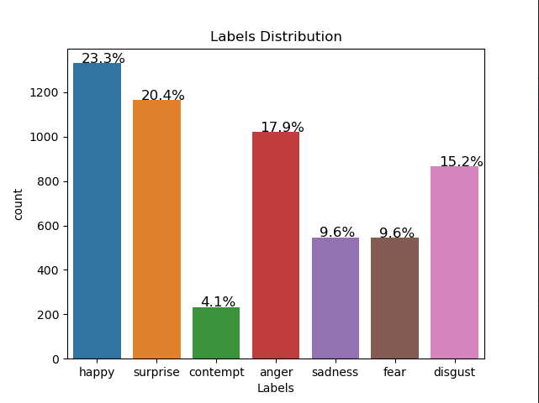
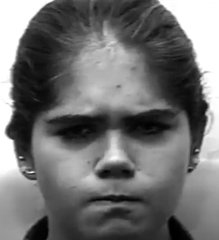
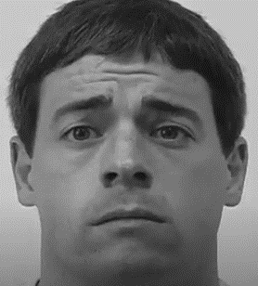
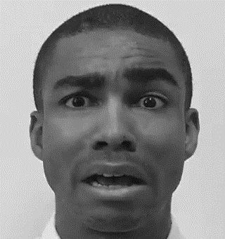
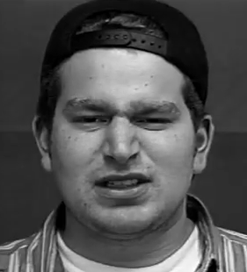
7 Target values
Happy
Surprise
Contempt
Anger
Sadness
Fear
Disgust
Notes:
There are a total of 7 types of emotions, 7 target values.
When I examined the data, I found that the distribution is not balanced, and it's a challenge I need to handle later.

Slide 8
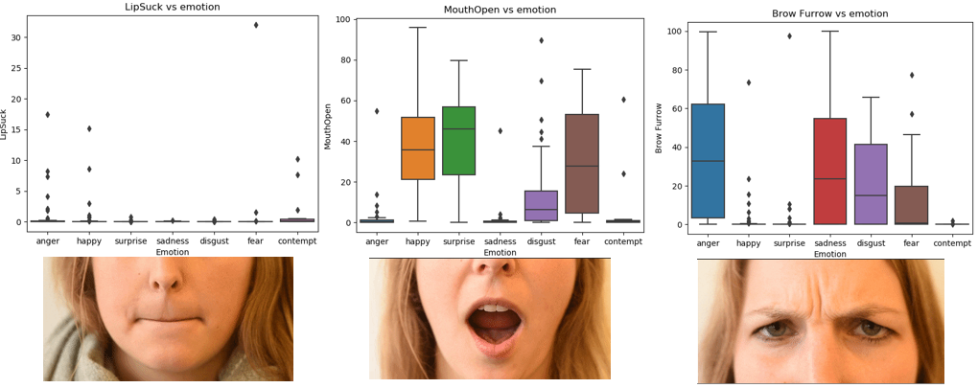
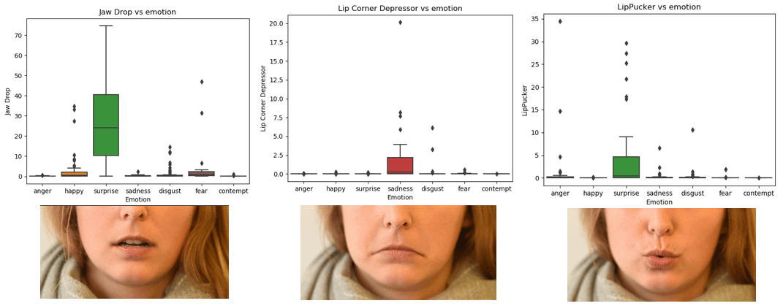
The relationship between target values to AUs

Slide 9
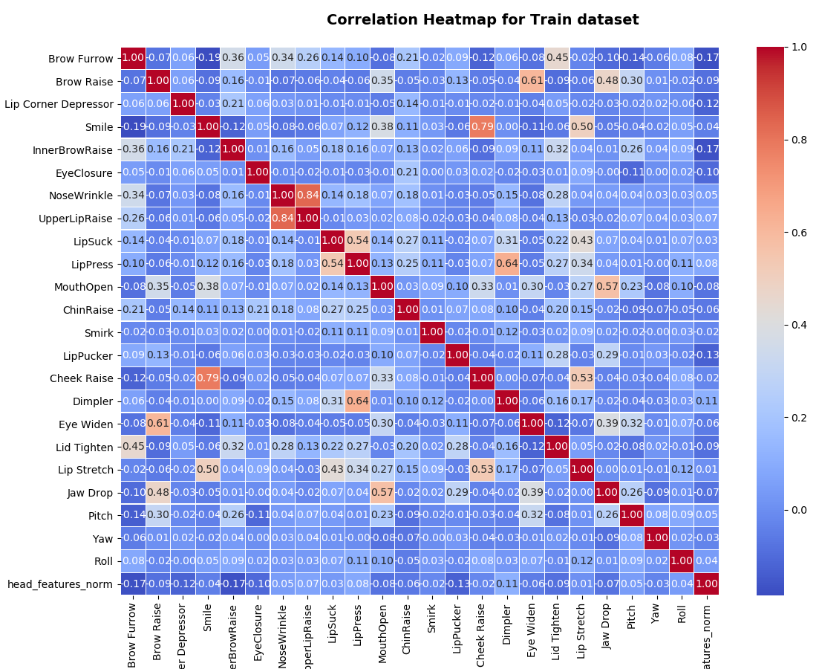

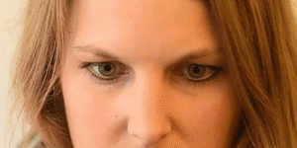

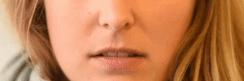
Nose Wrinkler
Cheek Raiser
VIF < 5
Smile
Correlation matrix
Upper Lip Raiser

Slide 10

Data Preparation
Missing & Abnormal values
Splitting to Train-set and Test-set

Slide 11
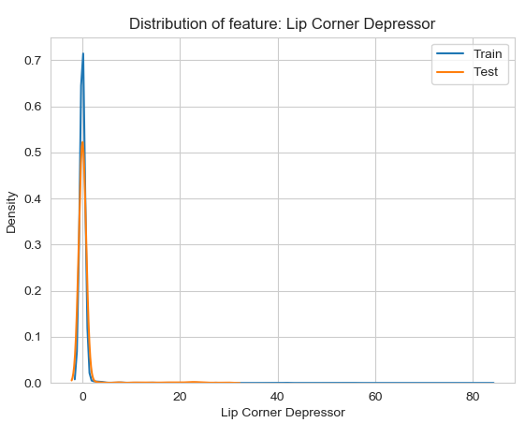
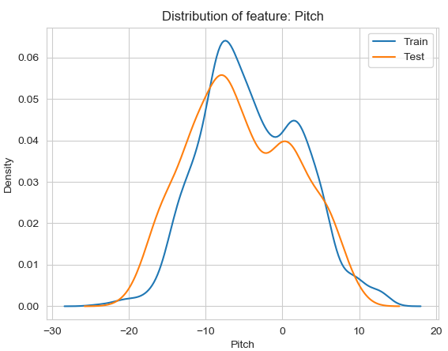
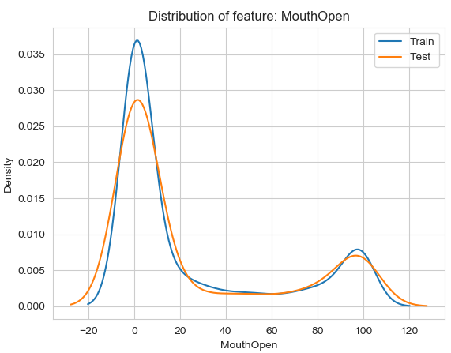
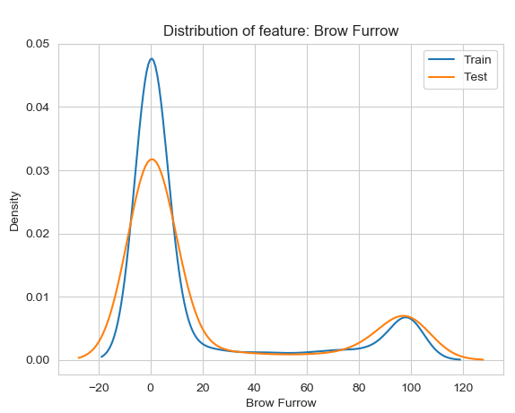
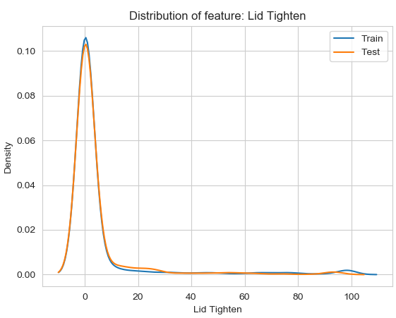
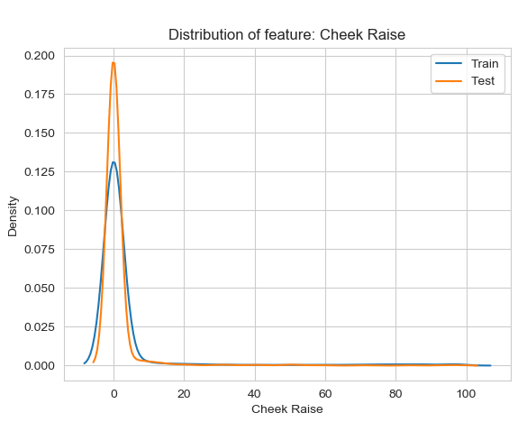
Train vs test feature distribution

Slide 12
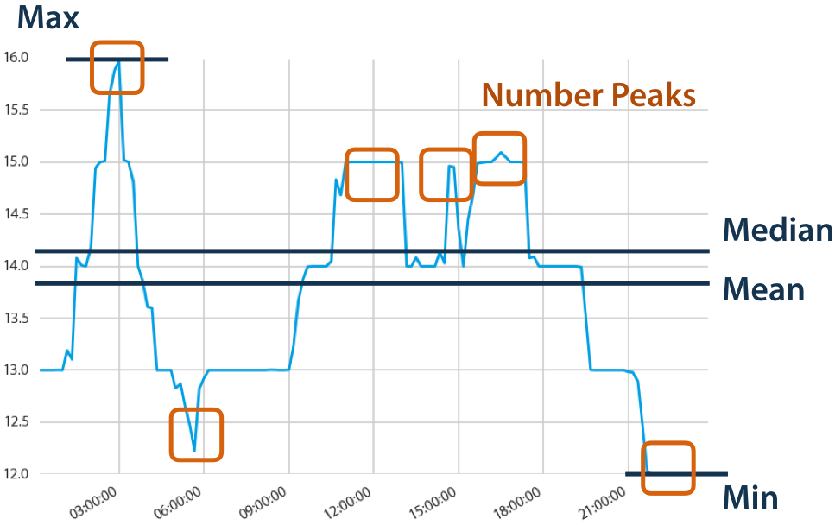
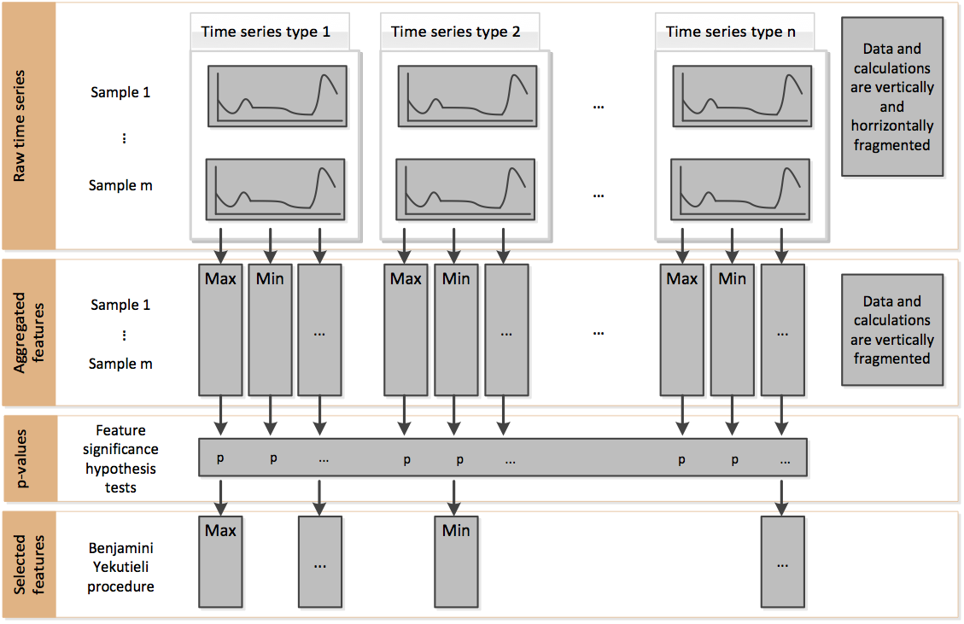
Features Extraction & Selection
TS-Fresh

Slide 13
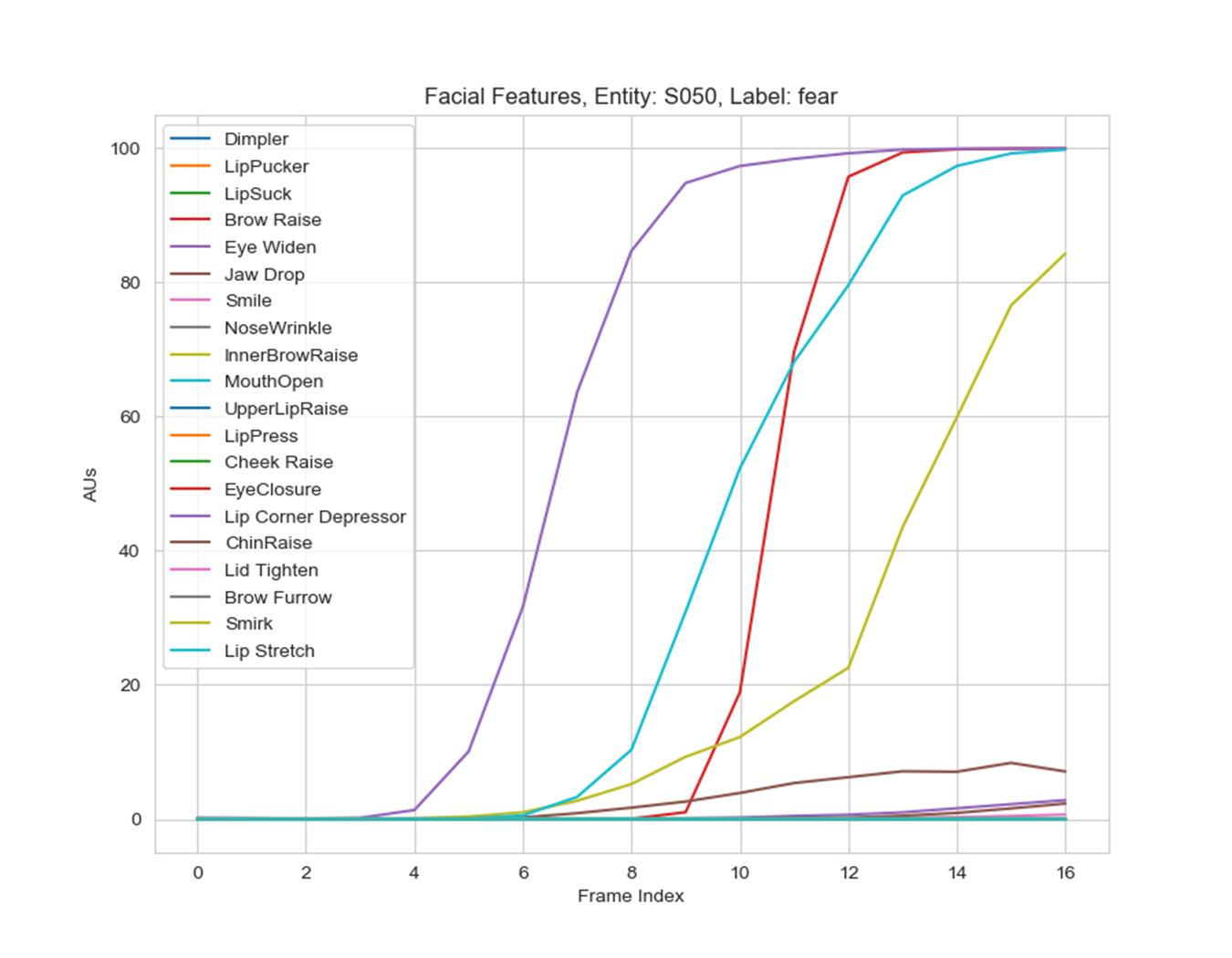
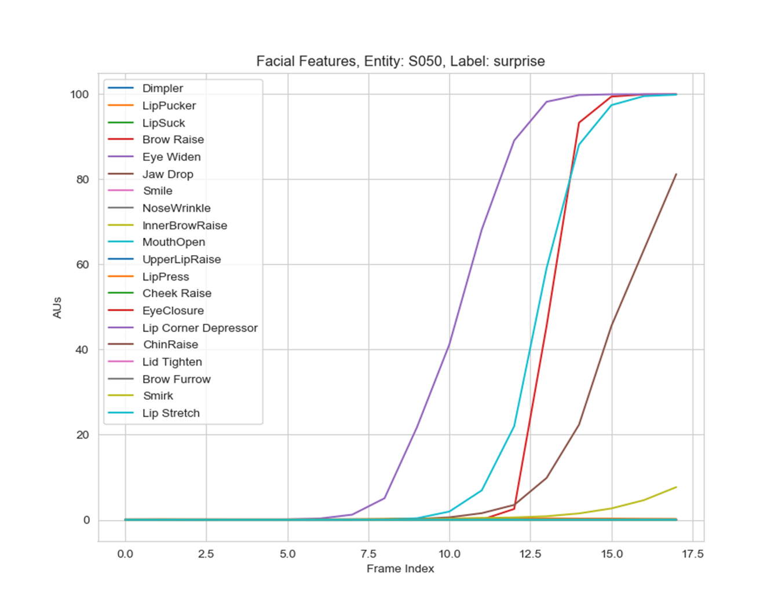
Features Extraction & Selection
Naive feature extraction

Slide 14
Naive Feature Extraction
Time | Brow Furrow | Brow Raise | Lip Corner Depressor | Pitch | Yaw | Roll | Inner Brow Raise | Eye Closure | Nose Wrinkle | Upper Lip Raise | LipSuck | Lip Press | Mouth Open | Chin Raise | Smirk | Lip Pucker | Cheek Raise | Dimpler | Eye Widen | Lid Tighten | Lip Stretch | Jaw Drop
0.00 | 0.00 | 0.00 | 0.00 | 1.80 | -1.29 | 0.67 | 0.02 | 0.00 | 0.00 | 0.00 | 0.04 | 0.01 | 0.03 | 0.00 | 0.01 | 0.01 | 0.00 | 0.01 | 0.03 | 0.01 | 0.00 | 0.04
40.00 | 0.00 | 0.00 | 0.00 | 1.31 | 2.06 | 0.75 | 0.01 | 0.00 | 0.00 | 0.00 | 0.03 | 0.01 | 0.06 | 0.01 | 0.02 | 0.02 | 0.00 | 0.02 | 0.12 | 0.02 | 0.00 | 0.06
80.00 | 0.00 | 0.00 | 0.00 | 2.28 | 0.24 | 1.51 | 0.01 | 0.00 | 0.00 | 0.00 | 0.03 | 0.01 | 0.06 | 0.01 | 0.06 | 0.01 | 0.00 | 0.01 | 0.12 | 0.01 | 0.01 | 0.08
120.00 | 0.00 | 0.00 | 0.00 | 1.69 | 1.41 | 1.16 | 0.01 | 0.00 | 0.00 | 0.00 | 0.03 | 0.01 | 0.07 | 0.02 | 0.06 | 0.02 | 0.00 | 0.01 | 0.09 | 0.01 | 0.01 | 0.10
160.00 | 0.00 | 0.00 | 0.00 | 2.51 | 1.32 | 0.81 | 0.01 | 0.00 | 0.00 | 0.00 | 0.02 | 0.01 | 0.06 | 0.01 | 0.08 | 0.01 | 0.00 | 0.01 | 0.11 | 0.01 | 0.01 | 0.11
200.00 | 0.00 | 0.00 | 0.00 | 2.08 | 1.30 | 1.11 | 0.01 | 0.00 | 0.00 | 0.00 | 0.03 | 0.01 | 0.14 | 0.02 | 0.14 | 0.01 | 0.00 | 0.01 | 0.13 | 0.01 | 0.01 | 0.15
240.00 | 0.00 | 0.00 | 0.00 | 3.54 | 0.64 | 1.01 | 0.01 | 0.00 | 0.00 | 0.00 | 0.04 | 0.04 | 0.25 | 0.04 | 0.28 | 0.01 | 0.01 | 0.02 | 0.13 | 0.01 | 0.05 | 0.14
280.00 | 0.00 | 0.00 | 0.00 | 2.41 | -1.98 | 0.47 | 0.01 | 0.00 | 0.00 | 0.00 | 0.05 | 0.25 | 0.47 | 0.07 | 0.59 | 0.01 | 0.02 | 0.03 | 0.13 | 0.01 | 0.18 | 0.10
320.00 | 0.00 | 0.00 | 0.00 | 1.97 | -2.13 | 0.62 | 0.01 | 0.00 | 0.00 | 0.00 | 0.06 | 2.74 | 0.55 | 0.13 | 0.83 | 0.00 | 0.05 | 0.04 | 0.10 | 0.02 | 0.86 | 0.07
360.00 | 0.00 | 0.00 | 0.00 | 2.17 | -0.04 | 1.09 | 0.01 | 0.00 | 0.00 | 0.00 | 0.05 | 17.47 | 0.69 | 0.20 | 1.02 | 0.00 | 0.13 | 0.05 | 0.10 | 0.03 | 3.20 | 0.06
400.00 | 0.00 | 0.00 | 0.00 | 3.28 | 0.14 | 0.49 | 0.00 | 0.00 | 0.00 | 0.00 | 0.05 | 69.91 | 0.84 | 0.30 | 0.94 | 0.00 | 0.29 | 0.07 | 0.10 | 0.05 | 8.40 | 0.05
440.00 | 0.00 | 0.00 | 0.00 | 2.08 | 0.05 | 0.95 | 0.00 | 0.00 | 0.00 | 0.00 | 0.04 | 93.51 | 1.25 | 0.43 | 0.82 | 0.00 | 0.60 | 0.07 | 0.09 | 0.08 | 21.06 | 0.04
480.00 | 0.00 | 0.00 | 0.00 | 2.17 | -0.05 | 0.47 | 0.00 | 0.00 | 0.00 | 0.00 | 0.04 | 96.74 | 2.00 | 0.53 | 0.48 | 0.00 | 1.22 | 0.08 | 0.09 | 0.13 | 32.81 | 0.04
520.00 | 0.00 | 0.00 | 0.00 | 0.92 | -0.14 | 1.35 | 0.00 | 0.00 | 0.00 | 0.00 | 0.04 | 97.75 | 4.53 | 1.09 | 0.34 | 0.00 | 2.26 | 0.11 | 0.09 | 0.28 | 50.96 | 0.04
560.00 | 0.00 | 0.00 | 0.00 | 1.66 | -0.43 | 0.69 | 0.00 | 0.00 | 0.00 | 0.00 | 0.04 | 95.31 | 9.71 | 1.64 | 0.25 | 0.00 | 3.81 | 0.13 | 0.08 | 0.46 | 58.99 | 0.04
600.00 | 0.00 | 0.00 | 0.00 | 2.12 | -0.05 | 0.70 | 0.00 | 0.00 | 0.00 | 0.00 | 0.05 | 94.41 | 21.14 | 3.30 | 0.18 | 0.00 | 6.23 | 0.19 | 0.08 | 0.89 | 71.43 | 0.04
Brow Furrow1 | Brow Raise1 | Lip Corner Depressor1 | Pitch1 | …
0.00 | 0.00 | 0.00 | 1.80 | …..
Brow Furrow2 | Brow Raise2 | Lip Corner Depressor2 | Pitch2
0.00 | 0.00 | 0.00 | 1.31
Brow Furrow3 | Brow Raise3 | Lip Corner Depressor3 | Pitch3
0.00 | 0.00 | 0.00 | 2.41
Brow Furrow4 | Brow Raise4 | Lip Corner Depressor4 | Pitch4
0.00 | 0.00 | 0.00 | 1.97
Brow Furrow5 | Brow Raise5 | Lip Corner Depressor5 | Pitch5
0.00 | 0.00 | 0.00 | 1.66

Slide 15
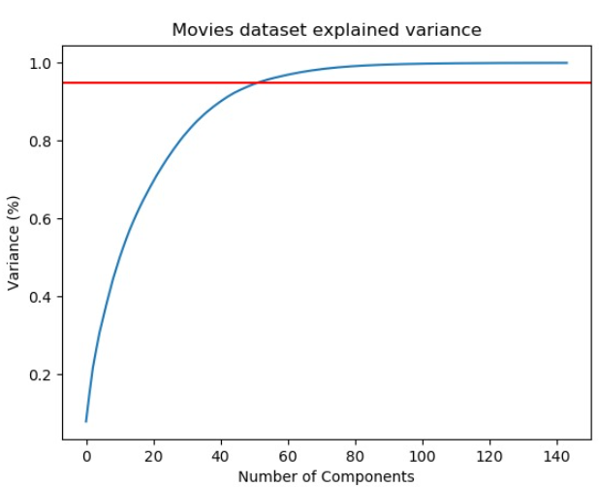
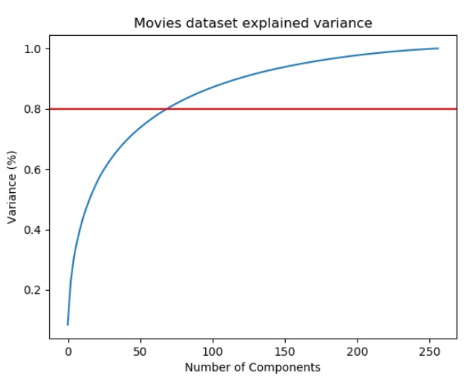
Dimensionality reduction
Naïve
TS-Fresh
Notes:
To determine the number of components, I used the elbow rule, but it should be a hyper-parameter when checking the model's performance.
With PCA I got 50 features for the naive approach
and 70 features for the TS-FRESH approach.

Slide 16
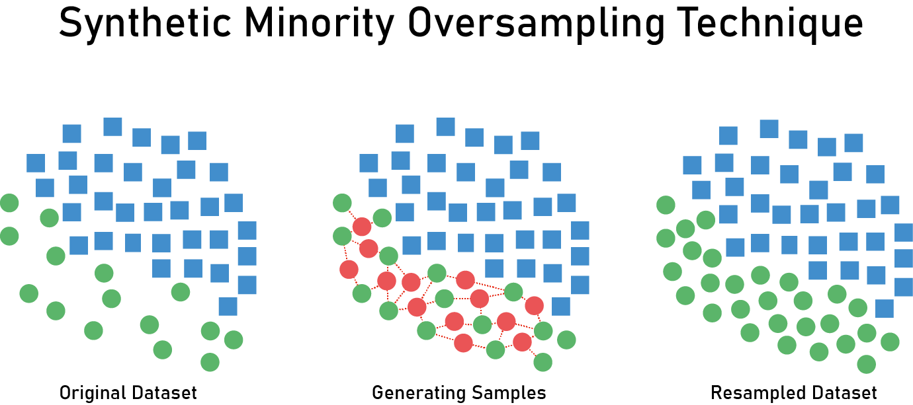
Notes:
In order to proceed to the modeling stage, I have to deal with the imbalanced data problem.
I chose to do up-sampling with SMOTE.
It creates artificial samples based on near neighbors' samples.
The biggest disadvantage is of using SMOTE is that it creates new samples that don't reflect the real world, so the cost of using SMOTE is adding some bias to the data.

Slide 17

Analysis / Modeling
Naïve Baseline + RF
TS-Fresh + RF
TS-Fresh + GBM
Naïve Baseline + GBM
Notes:
For this project, I chose to use RF and GBM models.
As a result, I have 4 different models:
RF and naive feature extraction
RF and TS-FRESH feature extraction
GBM and naive feature extraction
GBM and TS-FRESH feature extraction
Also, I use K FOLD as a validation method for the stage of tuning hyperparameters.

Slide 18

Evaluation
TS-Fresh + RF
TS-Fresh + GBM
Naïve
+ RF
Naïve + GBM
f1 | 0.87 | 0.83 | 0.74 | 0.72

Slide 19
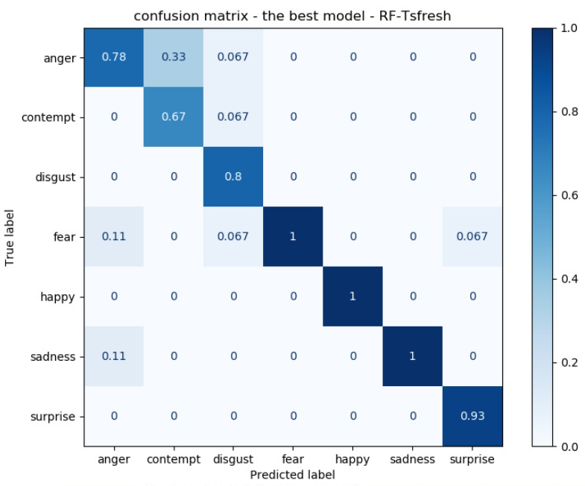

Slide 20
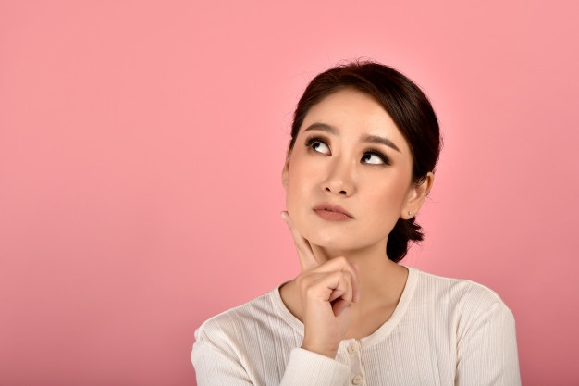
Questions?

